Slide 1



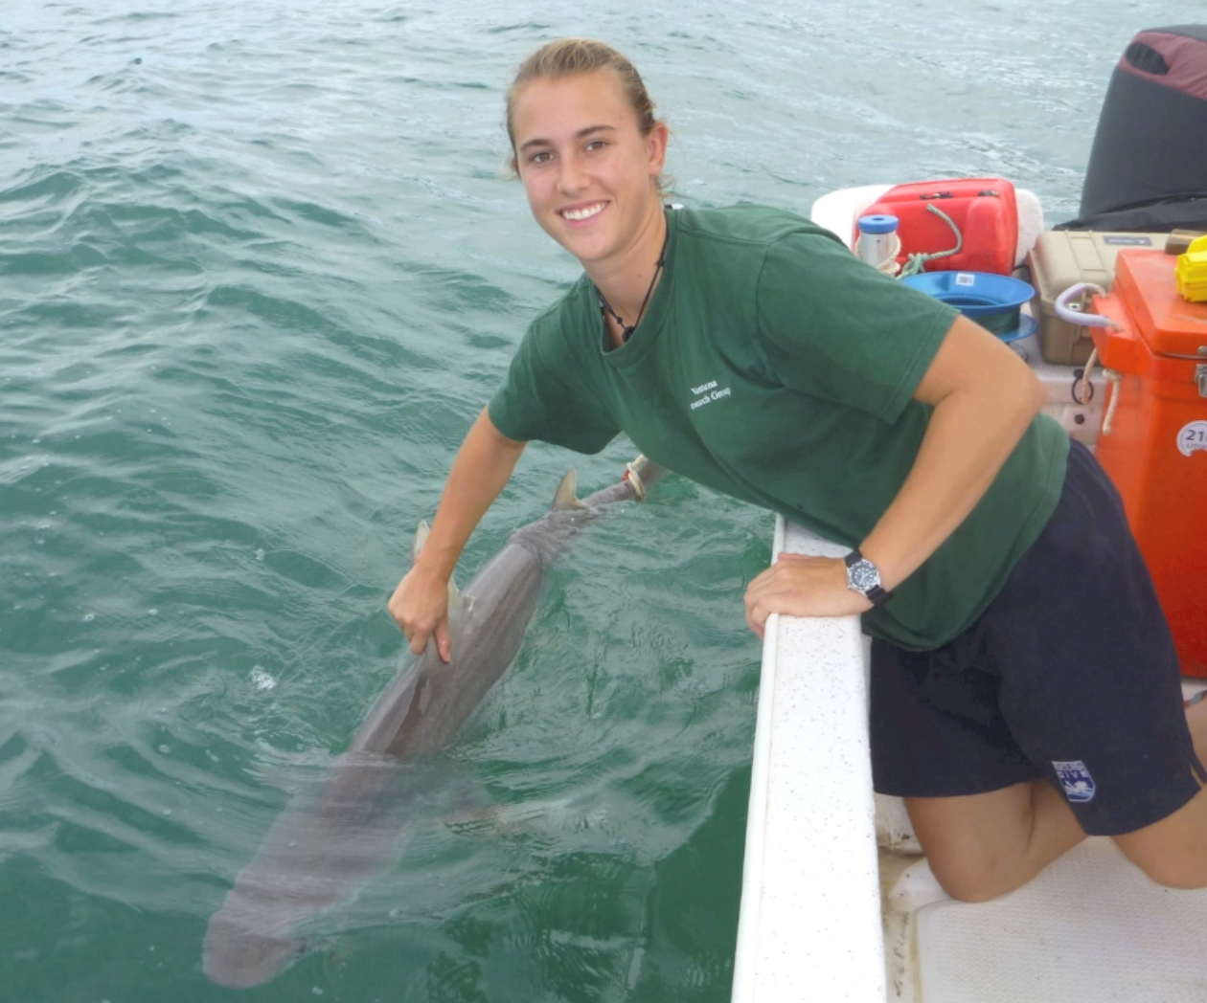
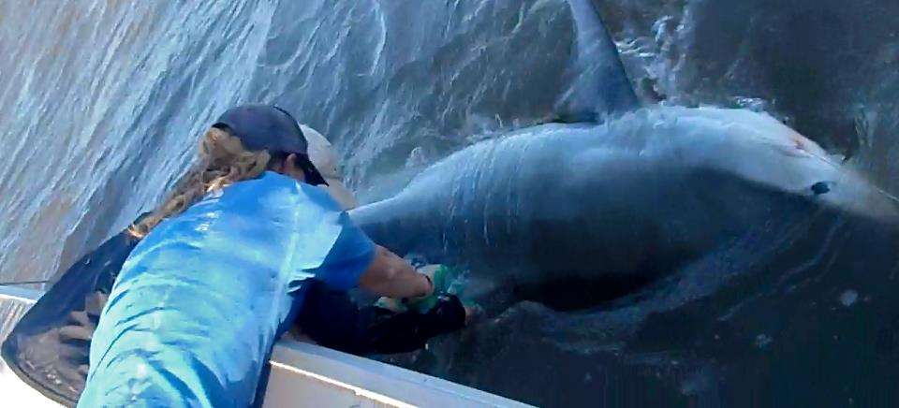
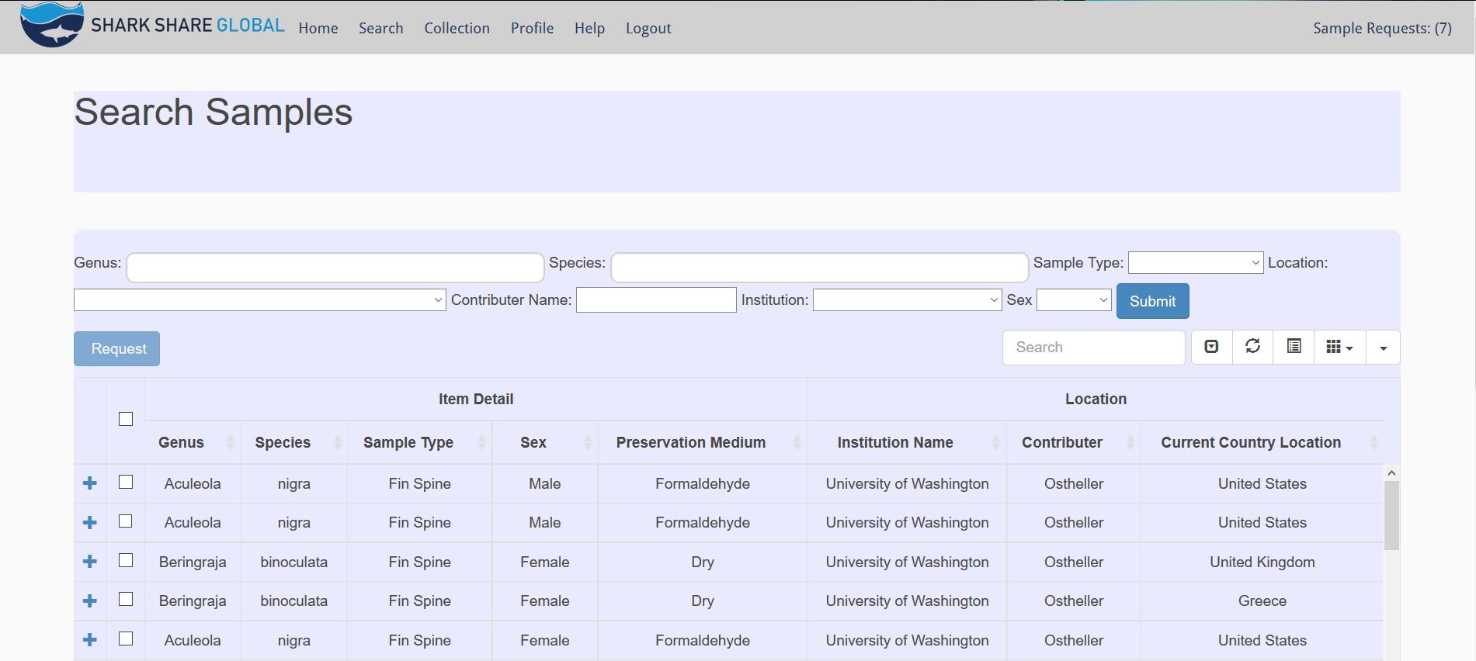



Heather Moore
Elizabeth MacCready
Molly Ostheller
Problem
Process
Solution
Sharks are economically and environmentally important, and many are endangered by human impact.
47% of shark and ray species are data deficient.
Collaboration and sample sharing between researchers is hampered by distance and lack of communication opportunities. This results in wasted samples, and
wasted research opportunities.
Catered to shark and ray researchers
We determined our audience is:
Comfortable with basic computer functionality
Storing data in spreadsheet formats
Not used to online collaboration and concerned about the sample-sharing process
Our build priorities: maximize reach, minimize maintenance, and run on low cost
We needed a low barrier for adoption for both the audience and our sponsor
We needed to set scope boundaries early to accommodate our small team size
Web app that allows for collaboration between scientists
Increases confidence in sharing and collaboration by:
Putting attribution of work and sample ownership at the forefront
Mimicking existing processes (storage, communication) that researchers are used to, while ‘supercharging’ them with the new database
The site is cloud hosted for global accessibility and performance through Amazon Web Services, and is custom built using MySQL and PHP on a Twitter Bootstrap framework
Our Sponsor
Founded by Madi Green and Lauren Meyer
Fosters global collaboration amongst shark scientists
Funding for the project was provided
by a generous grant from:
Next Steps
Go live for researcher use this summer
Social media campaign for adoption
Introduction at researcher conferences
Madi Green
Lauren Meyer
Photo Credit[1][2]: Green, M. and Meyer, L. Shark Share Global, sharkshareglobal.org accessed: 5/14/2016, Problem Statistics: 47% of sharks and rays are at risk: Dulvy, Nicholas K., et al. "Extinction risk and conservation of the world’s sharks and rays." Elife 3 (2014): e00590.. Our Sponsor Graphics courtesy of: saveourseas.com/projects/shark-share

